Slide 1
Image Histogram
Presented by
Nasima Islam Bithi
0421312032

Slide 2
Outline
Image Histogram
Histogram Equalization
Color Image Histogram
Adaptive Histogram Equalization (AHE)
Contrast Limited Adaptive Histogram Equalization (CLAHE)
References

Slide 3
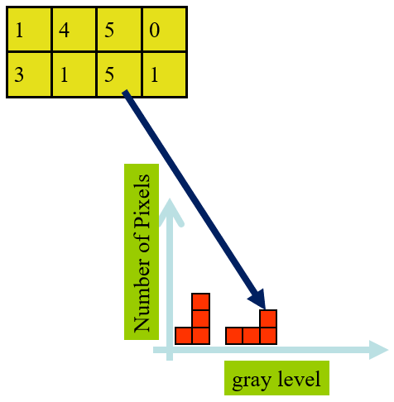
Image Histogram
Image histogram is a graphical representation of the intensity distribution of an image. Here the x-axis shows the gray level intensities and the y-axis shows the frequency of these intensities.
Fig. Histogram of a 3bpp Image

Slide 4
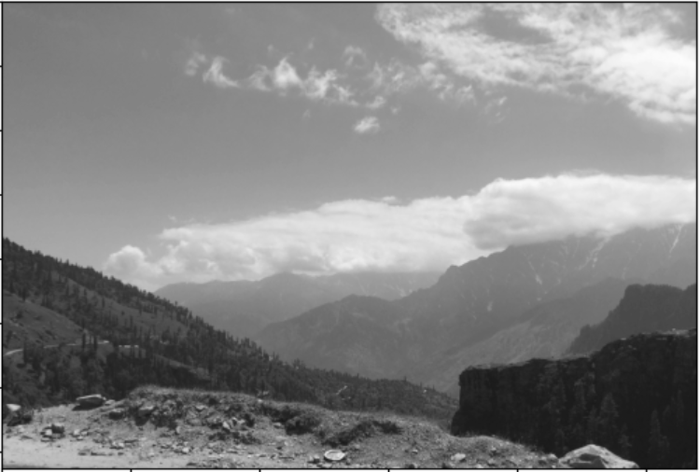
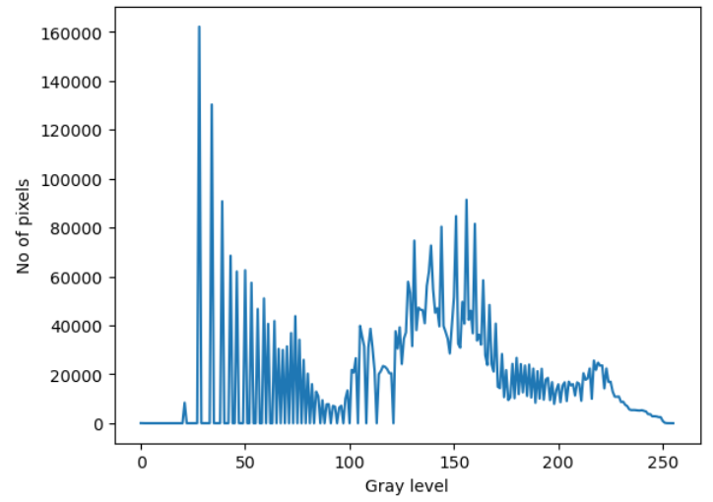
Gray Image Histogram
Original Image
Image Histogram
Number of gray levels= 2^8= 256
0
255
Black
White

Slide 5
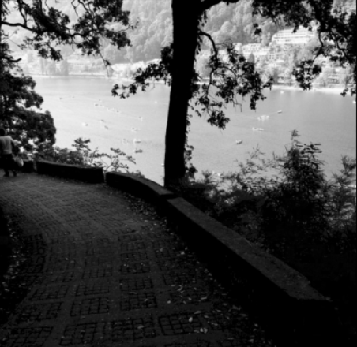

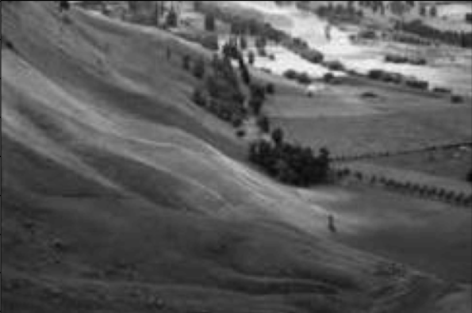
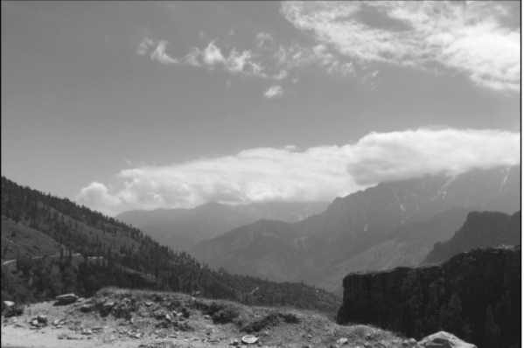
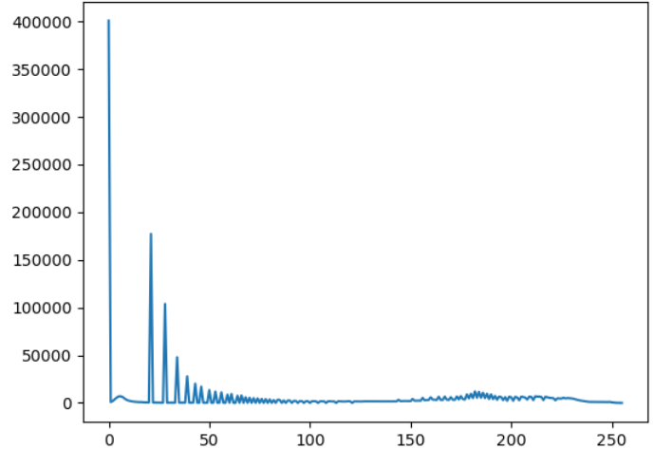
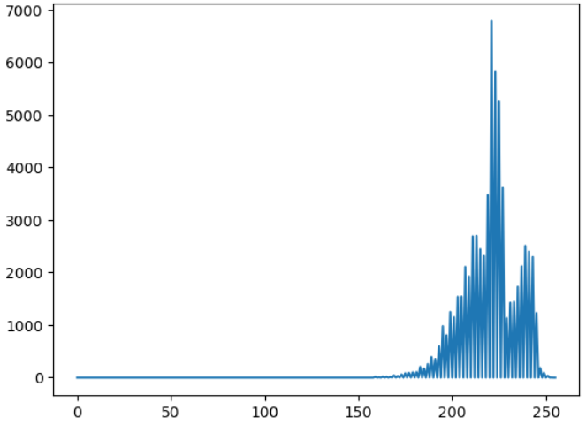
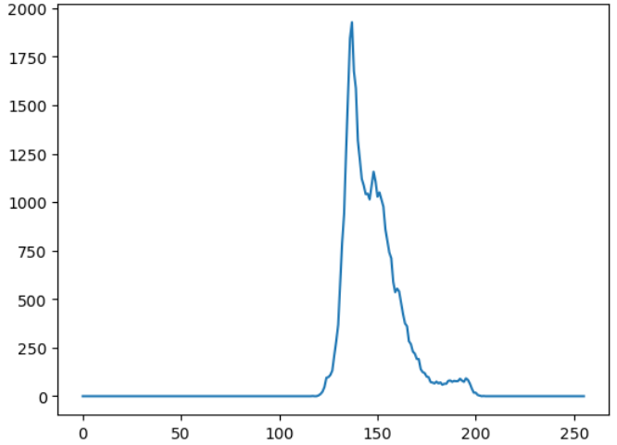
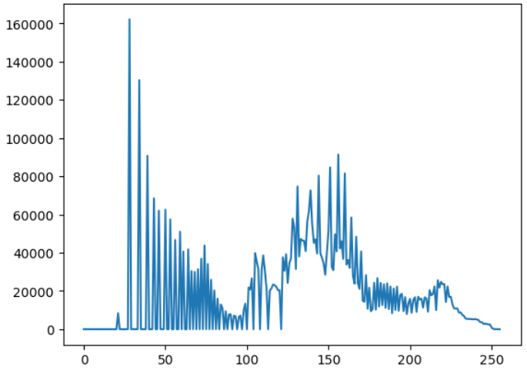
Some Typical Histograms
Dark Image
Bright Image
Low Contrast Image
High Contrast Image

Slide 6


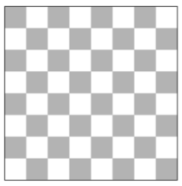
Example: Histograms
Different images can have the same histogram.
3 images below have the same histogram. Half of pixels are gray, half are white.
Can we reconstruct image from histogram? No!
Solution of the high resolution image (e.g. 32bpp): Binned histogram.

Slide 7
Applications of Image Histogram
For analyzing an image based on the properties of the histogram.
For adjusting contrast by histogram equalization.
For brightness purposes using histogram sliding.
Widely used in thresholding of computer vision.

Slide 8
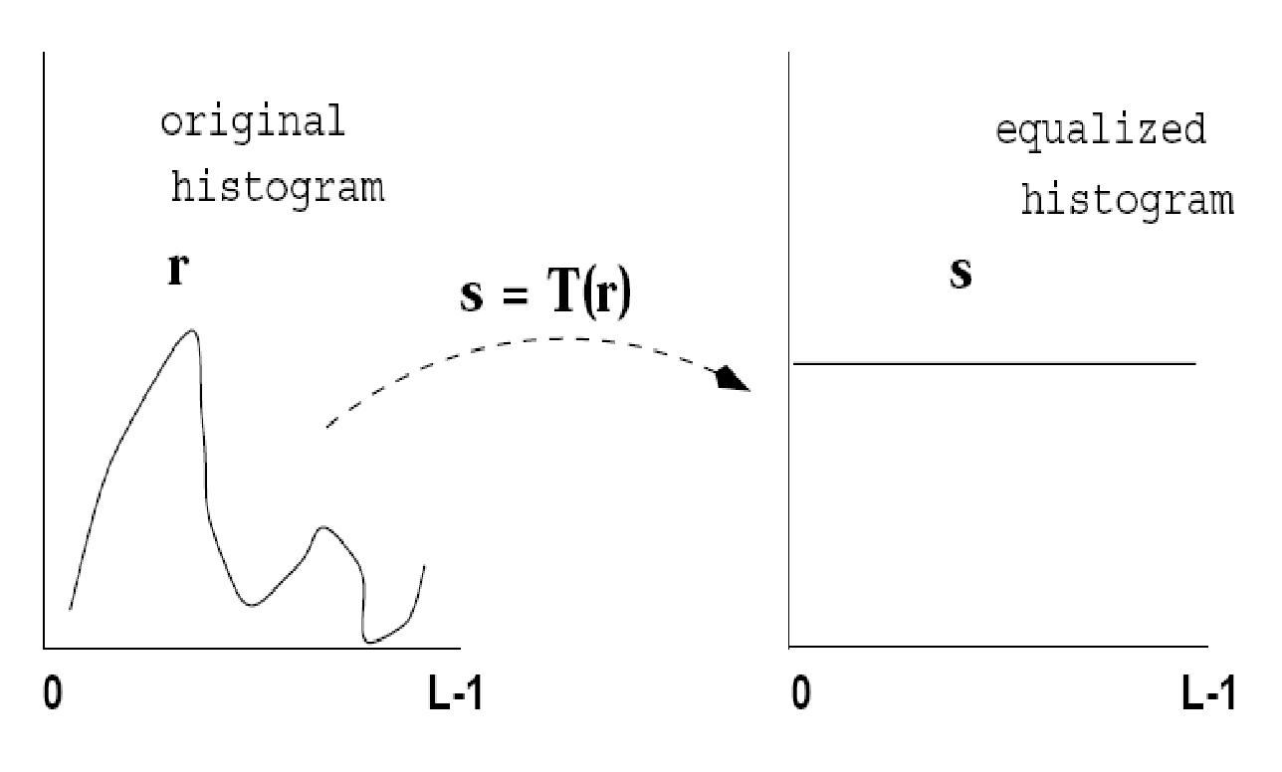
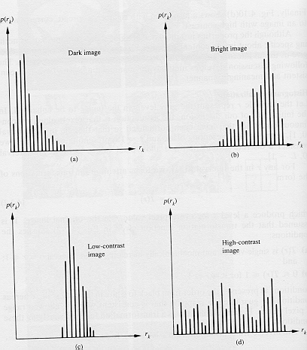
Histogram Equalization
The main idea is to redistribute the gray-level values uniformly which means spreading out the histogram to make full use of the image's dynamic range.It normalizes the brightness and increases the contrast of the image.

Slide 9
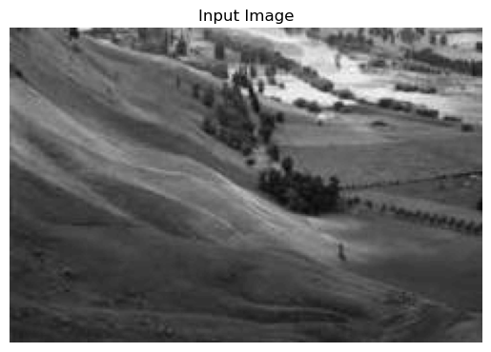
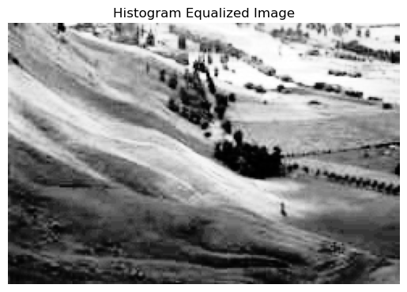
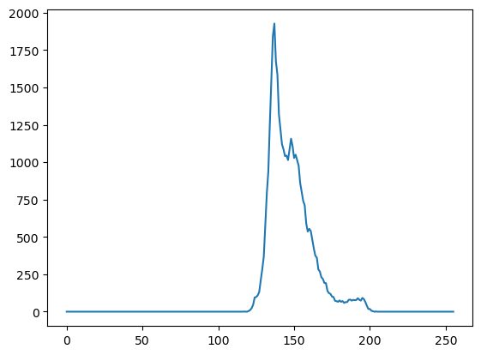
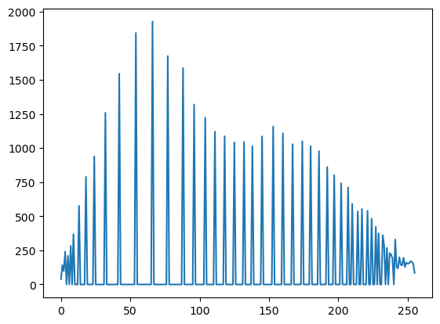
Histogram Equalization of Gray Image

Slide 10
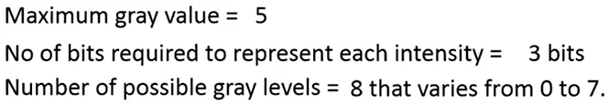
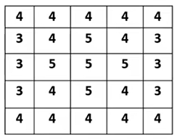
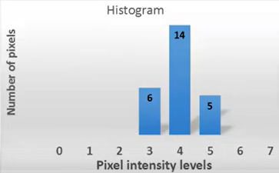
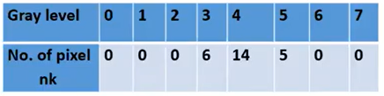
Example: Histogram Equalization
5×5 Image (3bpp)
Histogram of image

Slide 11
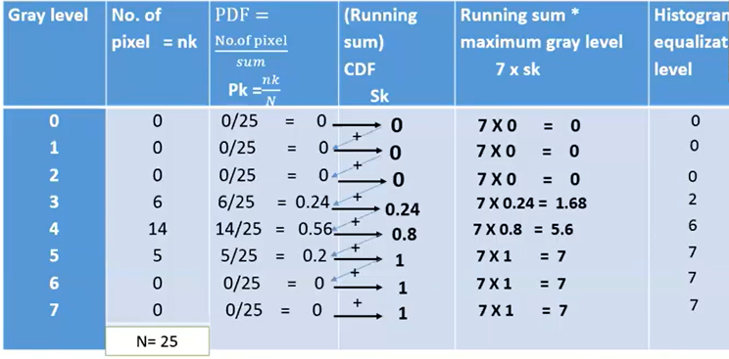
Implementation: Histogram Equalization
CDF is the normalized histogram. We multiply CDF with maximum gray value to get back the value between 0 to 7.

Slide 12
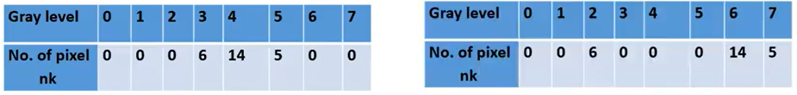
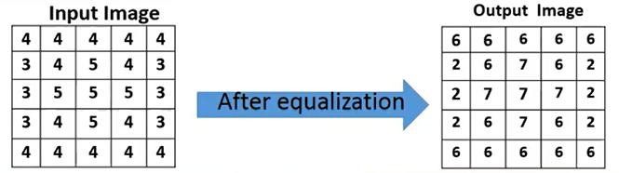
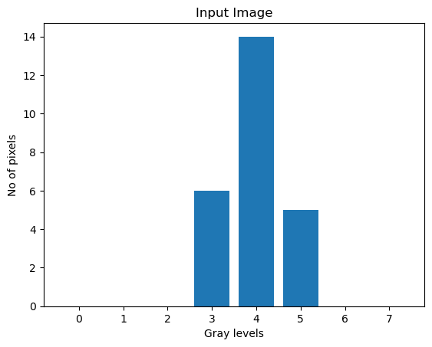
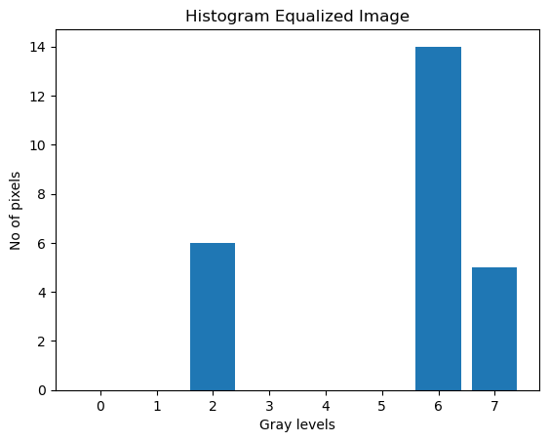
Implementation: Histogram Equalization

Slide 13
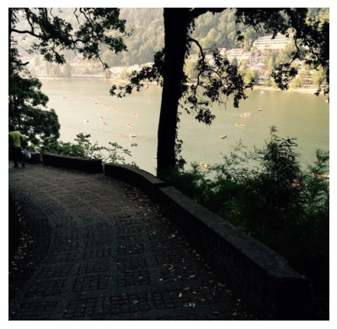
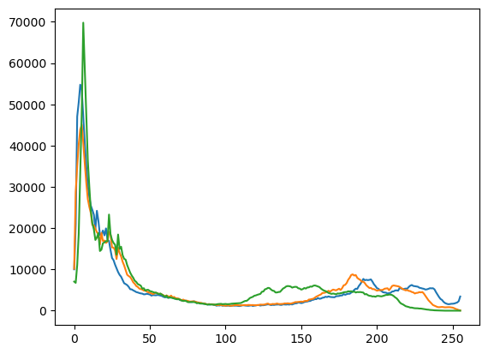
Color Image Histogram
Individual Color Channel Histograms: 3 histograms (R,G,B)
Dark RGB Image
Histogram of RGB Image

Slide 14
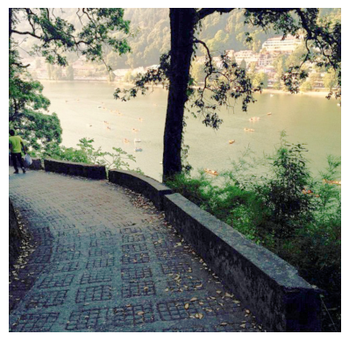
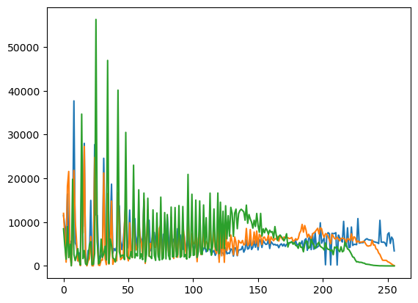
Histogram Equalization of Color Image
Input RGB Image
Histogram Equalized Image

Slide 15
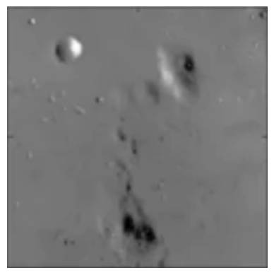
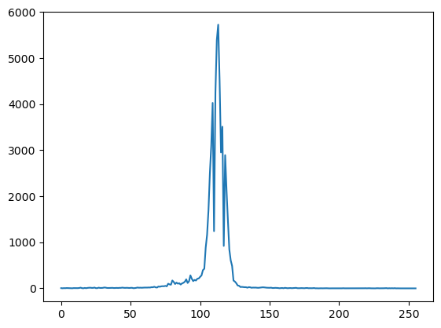
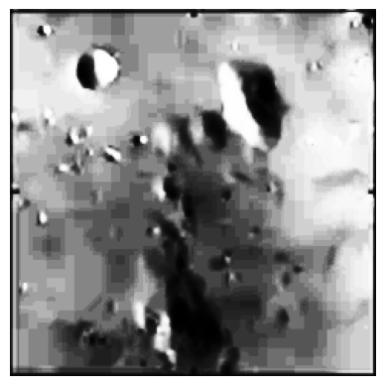
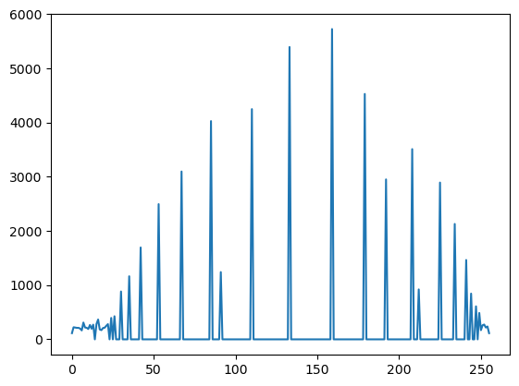
Limitations of Global Histogram Equalization
The image impurities are magnified in global histogram equalization as entire histogram is stretched between 0 to 255.
Low contrast image
Histogram equalized image

Slide 16
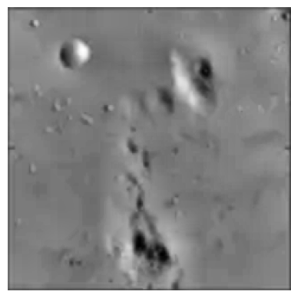
Adaptive Histogram Equalization (AHE)
Image is divided into small blocks called “tiles” (e.g. 8x8). Then each of these tiles are histogram equalized as usual. The neighboring tiles are then combined using bilinear interpolation to remove the artificial boundaries.
Input Image
Histogram Equalized Image
AHE Image

Slide 17
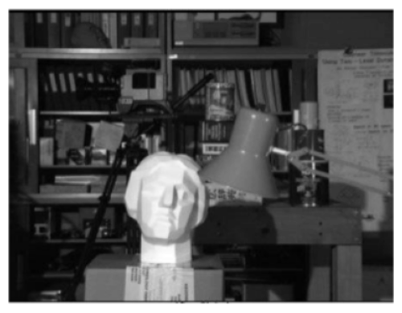
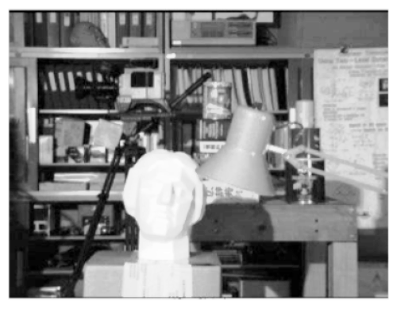
Limitations of AHE
The noise in relatively homogeneous region of the image is over-amplification of noise by AHE.
Input Image
AHE Image

Slide 18
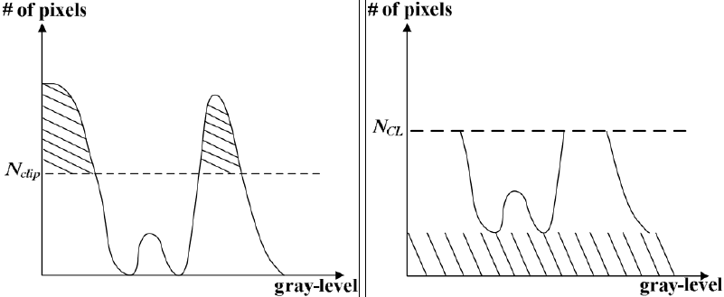
Contrast limited Adaptive Histogram Equalization (CLAHE)
CLAHE prevents the over-amplification of noise by clipping extra values.
If any histogram bin is above the specified contrast limit, those pixels are clipped and distributed uniformly to other bins before applying histogram equalization.
Original histogram
Clipped histogram

Slide 19
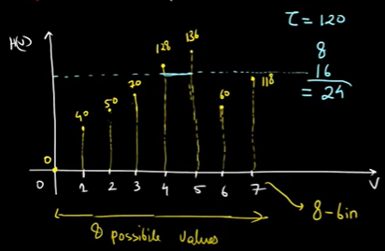
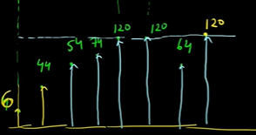
Clipped Histogram
After clipping with threshold = 120
Clipped histogram
Original histogram

Slide 20
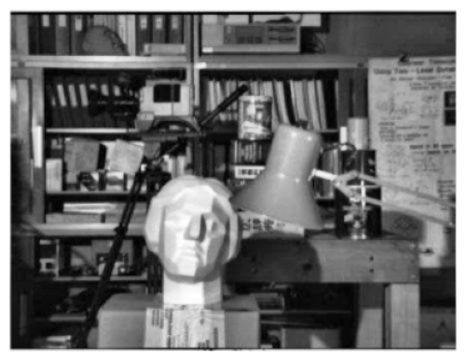
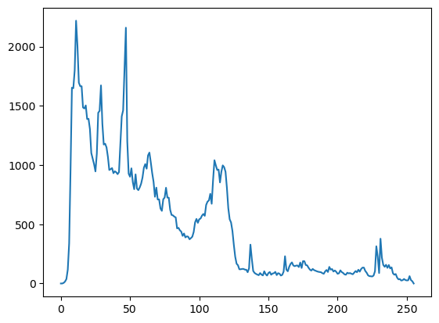
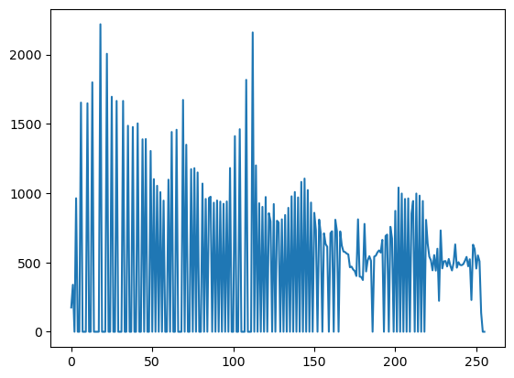
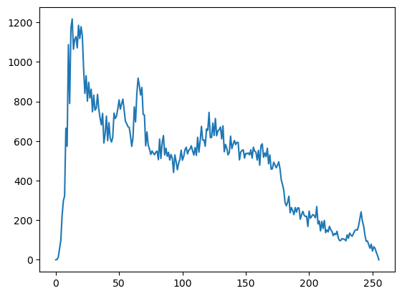
Example: CLAHE
Input Image
AHE Image
CLAHE Image

Slide 21
References
Wilhelm Burger and Mark J. Burge, Digital Image Processing, Springer, 2008 (chapter 4)
https://en.wikipedia.org/wiki/Image_histogram
https://www.tutorialspoint.com/dip/histogram_equalization.htm
https://homepages.inf.ed.ac.uk/rbf/HIPR2/histgram.htm
https://web.cs.wpi.edu/~emmanuel/courses/cs545/S14/slides/lecture02.pdf
Al-Ameen, Zohair & Sulong, Ghazali & Md Johar, Md Gapar. (2013). Employing a Suitable Contrast Enhancement Technique as a Pre-Restoration Adjustment Phase for Computed Tomography Medical Images. International Journal of Bio-Science and Bio-Technology. 5. 73 - 80.

